Slide 1
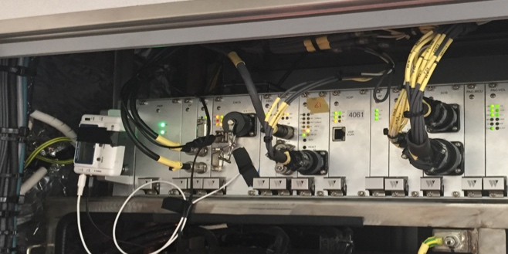
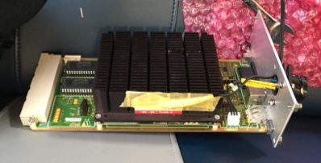
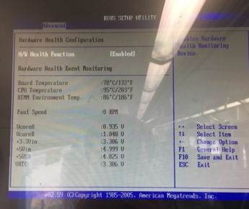
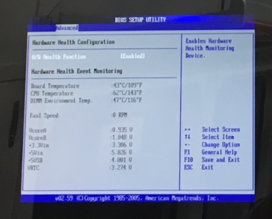
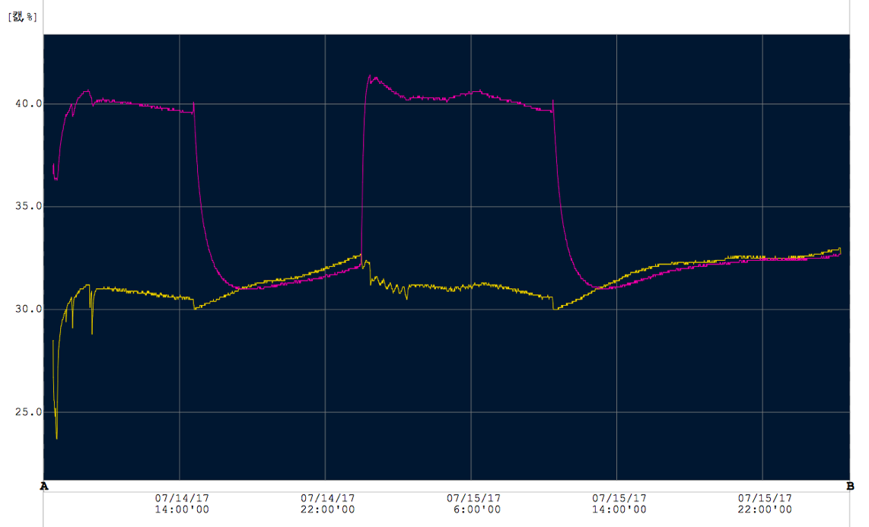
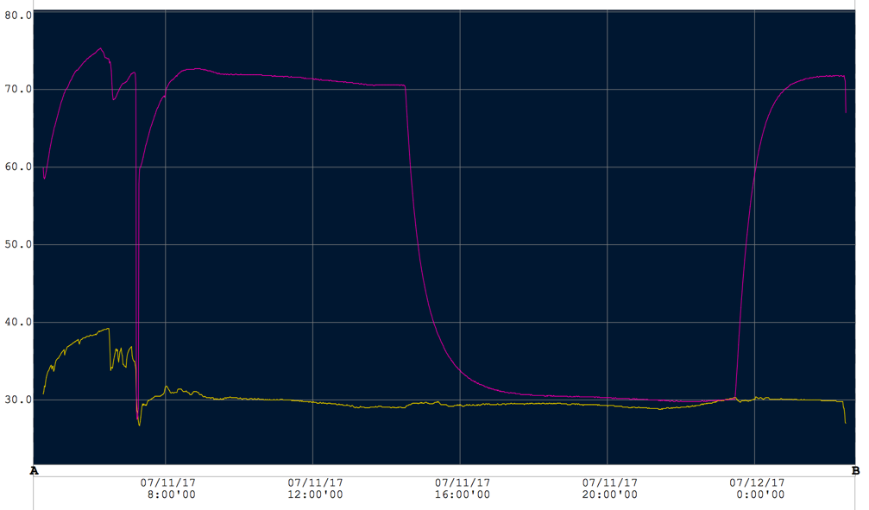
▣ Onboard Test Result Of Communication System Failure (FAN Installation 3/3)
◈ CRA-CNCS heating plate temperature change - Measured CRA-CNCS heating plate temperature change July 11. - CRA ambient temperature was measured max. 45°. | ◈ Test result - Two days monitoring of 4066 car after FAN installation on July 13th -> CPU internal temperature 95° → 62° -> CNCS heating plate 75° → 43° # Confirm cooling effect by FAN installation - FAN 2분만에 자동 방송 정상 동작, 20분후 주변온도까지
Before FAN installation
Test result after FAN installation
4066 CRA-CNCS heating plate temperature change
4066 CRA-CNCS heating temperature change
<CRA-CNCS heating plate>
Max 43°
/ average up to 40 °
<CRA-CNCS heating temperature>
Max 75°/ average 70°
<CRA CNCS ambient temperature>
Max. 40°/ average 30°
<CRA CNCS ambient temperature >
Max 35 ° / average 30°
# 4066 CRA-CNCS average heating temperature was 70°
# 4066 CRA-CNCS average heating temperature was 40 degree

